Slide 1
Final Project Presentation
Jot IT!
CS5610 Web Development
Ali Hamzehee

Slide 2
Content
Introduction
Architecture and technology stack
Data model
Demo
Reflection & future Works

Slide 3
Introduction

Slide 4
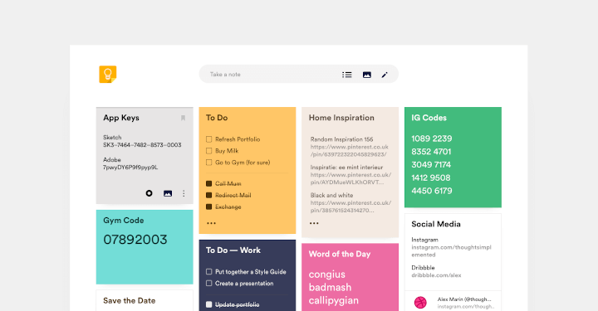
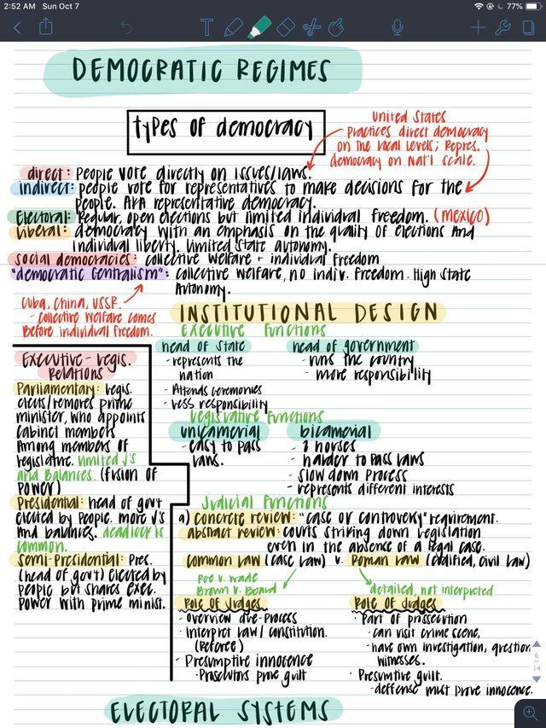

Problem to Solve
necessity of taking note.
Scattered notes.
accessible.
customized note
Solutions :
Centralized
easily access
Responsive page
customizable in future.

Slide 5
Architecture and technology stack

Slide 6






Technology
MERN Stack
DataBase
Mongo DB
Backend :
Node js
Expressjs
BCrypt
Mongoose
Front-end
react
react router
axios
bootstrap
redux
markdown

Slide 7
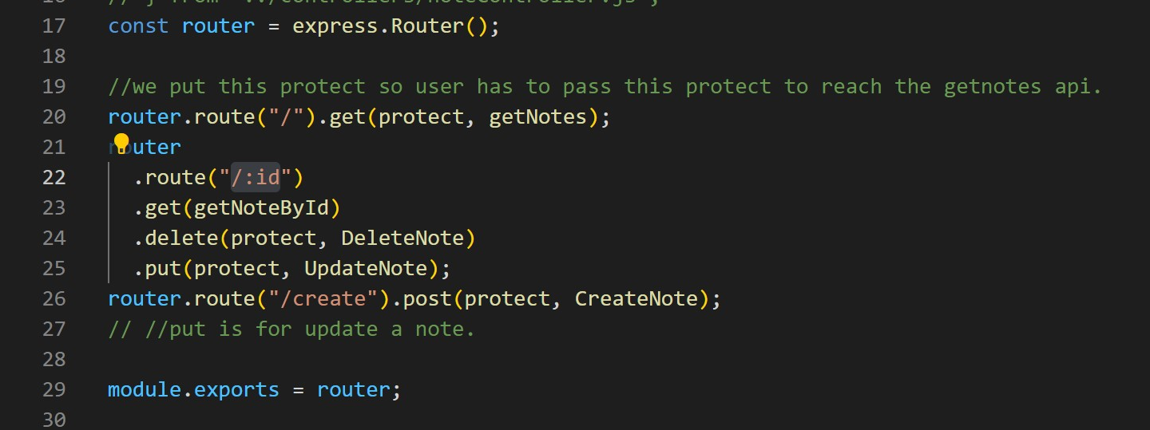
Architecture
Back-end
APIs:
/api/users/login
/api/users/profile
/api/users/newmembers
/api/notes/:id
/api/notes/create
Check authorization before any CRUD operations.

Slide 8
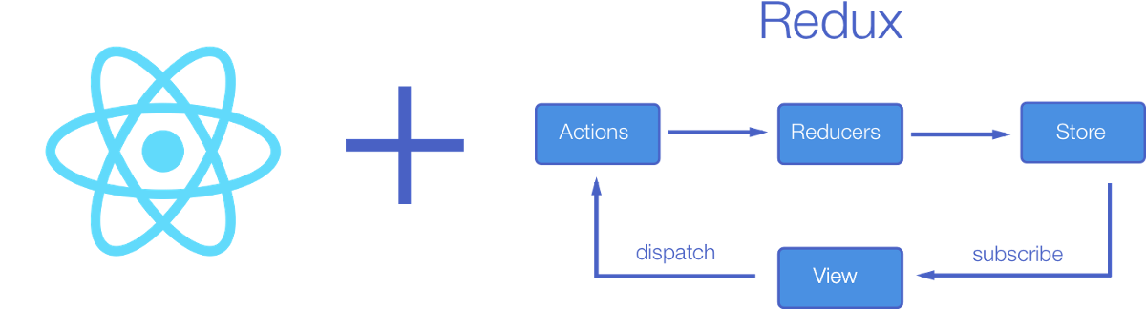
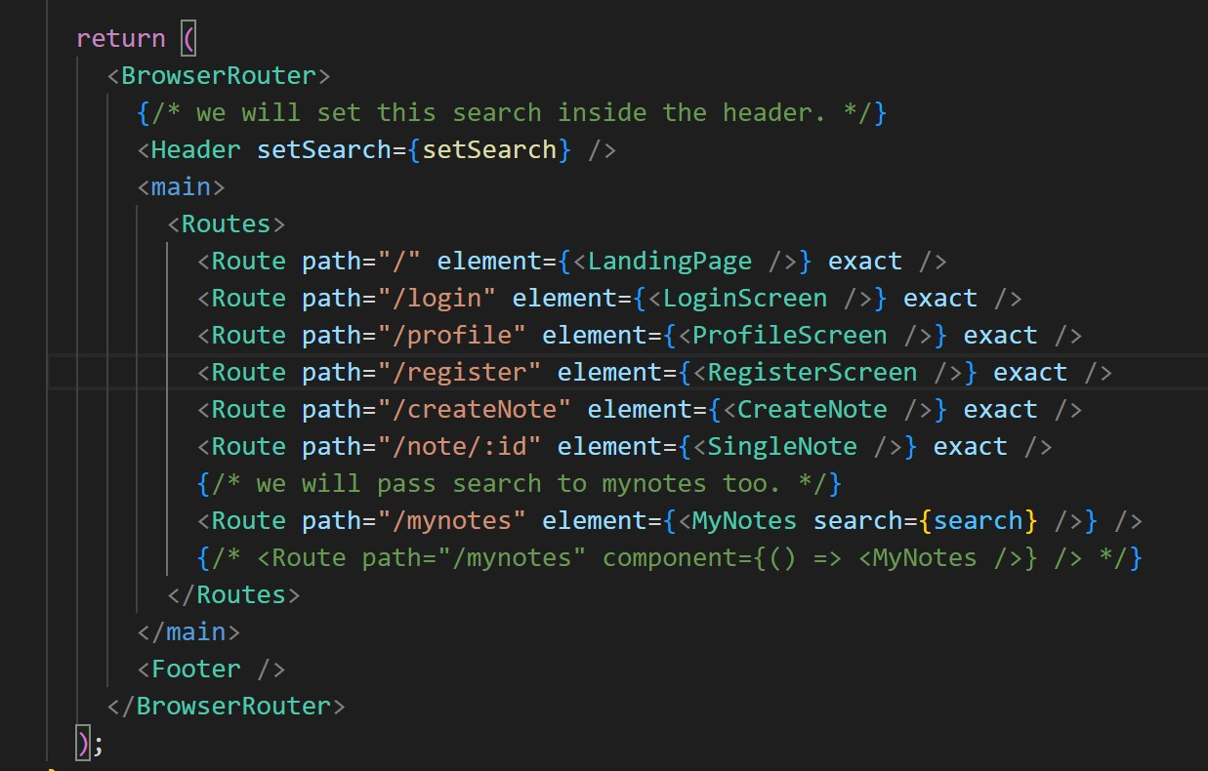


Architecture
Front-end
Routes :

Slide 9
Data Model

Slide 10
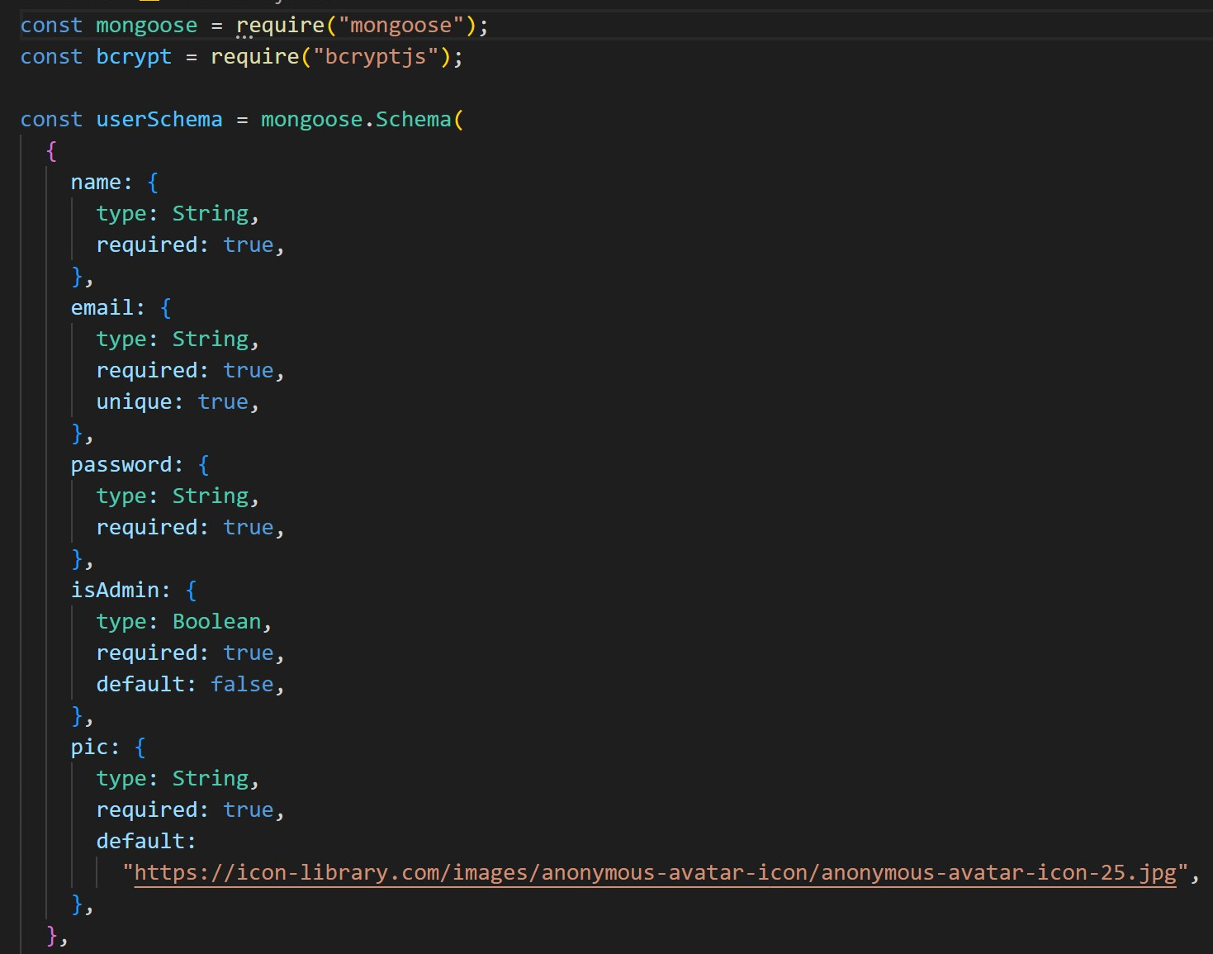
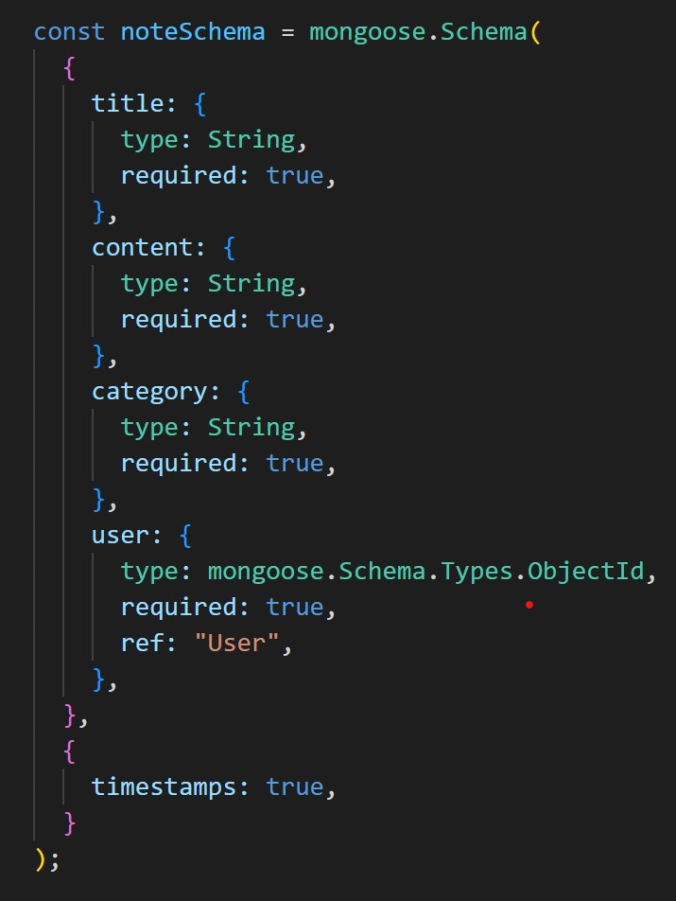
Data Model
Users-2 and Notes
Notes:
Environment as similar as possible, if not exactly the same

Slide 11
Demo

Slide 12
Reflection & future Works

Slide 13

advantages and Challenges
Advantages :
Building a personalized note taking app for my self
working with so many packages
Challenges
Deprecated packages
lack of time
publishing on heroku

Slide 14

Areas for Future Work
add category selector
personaliazed style
Mobile app
Make it scalable
Notes:
2 aggregation&calculation in DB

Slide 15
Thank for listening!

